Slide 1

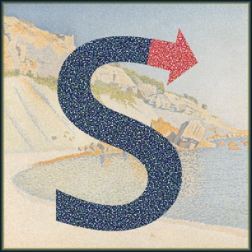
signac: A Python Framework for Data and Workflow Management
Vyas Ramasubramani, Carl S. Adorf,
Paul M. Dodd, Bradley D. Dice

Slide 2
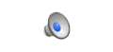
Flexible, Adaptable Data Management
Data protocols vary over project lifetimes
Parameter sweeps
Need to track where data came from and how to reproduce it
Need something that grows organically with the project
Video courtesy of Chrisy Xiyu Du
Notes:
Key point to emphasize: grows with the project. As you scale up your typical workflows, how do you adapt your data space, etc
----- Meeting Notes (6/29/18 14:35) -----
Be more concise

Slide 3
Planning a Parameter Study
concentration_A_0.25/
concentration_A_0.50/
concentration_A_0.75/
concentration_A/0.25
concentration_A/0.50
concentration_A/0.75
conc_A/0.25
conc_A/0.50
conc_A/0.75
conc_A/.25
conc_A/.50
conc_A/.75
conc_A/25
conc_A/50
conc_A/75
conc_A/25/temp_08
conc_A/25/temp_1
conc_A/50
conc_A/75
conc_A/25/temp_08
conc_A/25/temp_1
conc_A/50/temp_08
conc_A/75/temp_08
temp_08/conc_A/25
temp_08/conc_A/50
temp_08/conc_A/75
temp_1/conc_A/25
temp_08/conc_A/25/conc_B/05
temp_08/conc_A/50
temp_08/conc_A/75
temp_1/conc_A/25
Notes:
Points to state:
How do you select data? How do you search? How do you subset?
How do you automate the workflow? Do you just run each step manually? How do you avoid human error in the sequence?
How do you modify script generation? How do you switch between schedulers?
----- Meeting Notes (6/29/18 14:35) -----
Important points:
The order of the hierarchy changing
Try and connect more with the audience
Abbreviations?
What is implicit?
Reduce number of scripts.
Increase font size of workflow figure

Slide 4
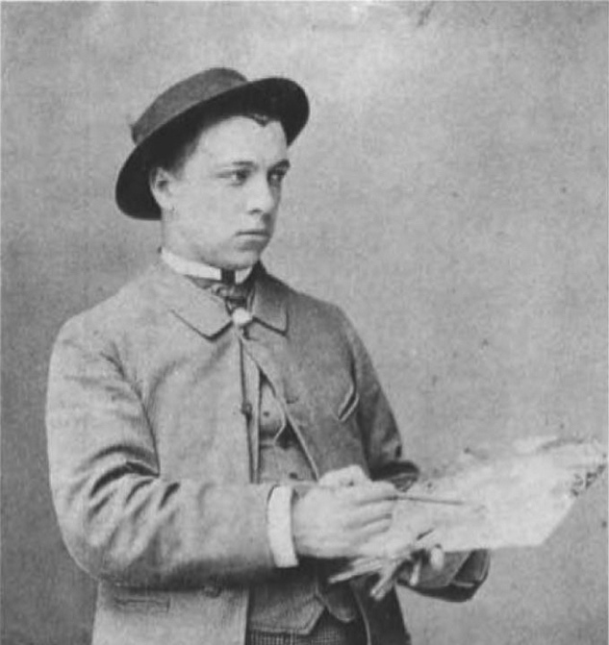


Why signac?
Paul Signac (1863-1935) and George Seurat (1859-1891) invented Pointillism
Cassis, Cap Lombard, Opus 196

Slide 5
Data and Workflow Management with signac
signac
signac-flow
signac: A Python framework for data and workflow management. In Proceedings of the 17th Python in Science Conference , In Preparation.
Notes:
----- Meeting Notes (6/29/18 14:35) -----
Focuses:
Hashing of the state point (the primary key)
We generally operate on a per-job basis.
Point out that the operations occur on a per-job basis as shown in the status tracking

Slide 6
Live Demo
https://github.com/vyasr/signac_scipy2018.git

Slide 7
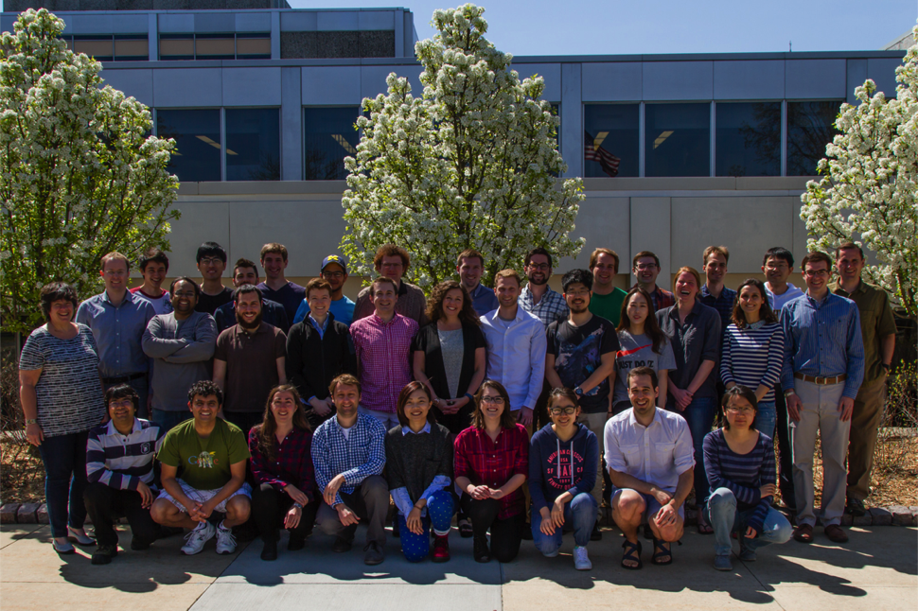


Thank you!
Signac is a product of The Glotzer Group at the University of Michigan. Development and deployment supported by MICCoM, as part of the Computational Materials Sciences Program funded by the U.S. Department of Energy, Office of Science, Basic Energy Sciences, Materials Sciences and Engineering Division, under Subcontract No. 6F-30844. Project conceptualization and implementation supported by the National Science Foundation, Award # DMR 1409620.
www.signac.io

Slide 8
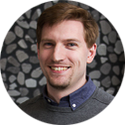
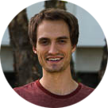

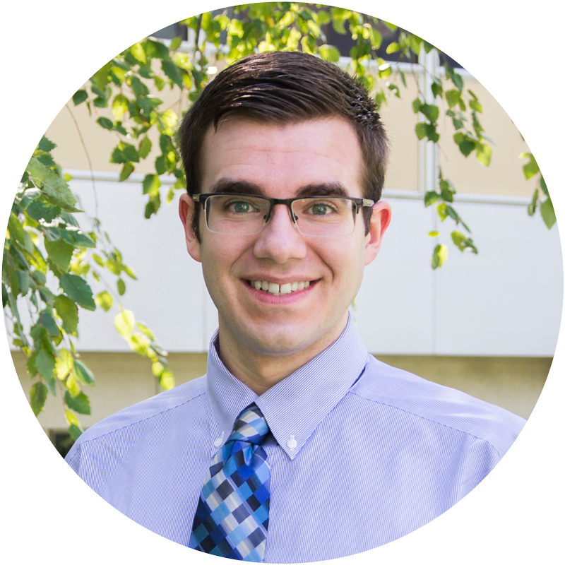
Thank you!
signac: A Python framework for data and workflow management. In Proceedings of the 17th Python in Science Conference , In Preparation.

